Slide 1
Project Methodologies and Processes
INFO 420 Fall 2024 Dr. Ram Arthanari
2-<number>

Slide 2
Learning Objectives
Define what a methodology is and describe the role it serves in IT projects.
Describe the project life cycle (PLC).
Describe the Project Management Body of Knowledge (PMBOK®) and be familiar with its knowledge areas and process groups.
Describe PRINCE2® and be familiar with its core principles, processes, and themes.
Describe the Systems Development Life Cycle ( SDLC).
Describe the Waterfall method for developing the project’s product or system.
Describe the Agile approach for developing the project’s product or system as well as two commonly used approaches called eXtreme Programming (XP) and Scrum..
Describe and apply the concept of Leaning Cycles and lessons learned.
2-<number>

Slide 3
Introduction
Project Methodology
  A strategic-level plan for managing and controlling the project
  Game plan for implementing project and product lifecycles
  Recommends phases, processes, tools, and techniques for supporting an IT project
  Must be flexible and include “best practices” learned from experiences over time.
Can be
  Traditional (e.g., Waterfall)
  Agile (e.g., XPM, SCRUM)
2-<number>

Slide 4
The Project Life Cycle
  Collection of logical stages or phases that
  maps the life of a project
  from its beginning, through its middle, to its end,
  to define, build, and deliver the product.
2-<number>

Slide 5
Project Phases
Phase Exits, Stage Gates, Kill Points
  These are the phase-end review of key deliverables
  Allows the organization to evaluate project performance and take immediate action to correct errors or problems
Fast Tracking
  Starting the next phase of a project before approval is obtained for the current phase
  Can be used to reduce the project schedule
  Can be risky and should only be done when the risk is acceptable
2-<number>

Slide 6
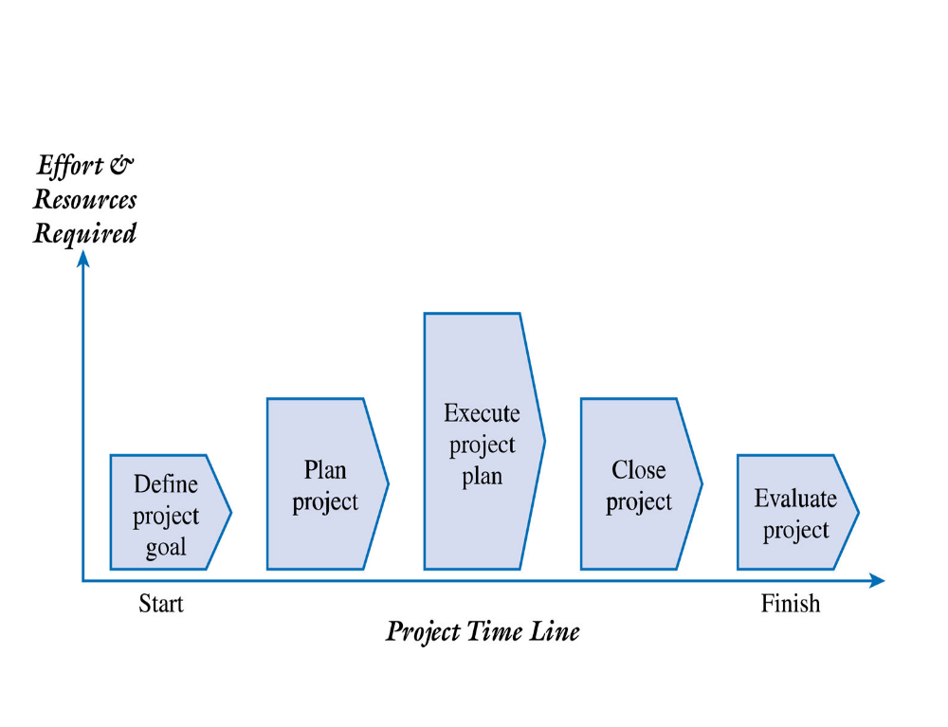
Figure 2.1 – A Generic Project Life Cycle
2-<number>

Slide 7
Project Life Cycle – Define and Plan
Define Project Goal
  The project goal should be focused on providing business value to the organization
  Provides a clear focus and drives the other phases of the project
  How will we know if this project is successful given the time, money, and resources invested?
Plan Project
  Project Objectives
  Resources
  Controls
2-<number>

Slide 8
Project Life Cycle – Execute, Close, and Evaluate
Execute Project Plan
  Manage the project scope, schedule, budget, and people to ensure the project achieves its goal
  Progress must be documented and compared to the baseline plan
  Project performance must be communicated to all of the stakeholders
Close and Evaluate Project
  Ensures that all of the work is completed as planned
  Final project report and presentation to the client
  Postmortem review
  Lessons learned and best practices documented and shared
2-<number>

Slide 9
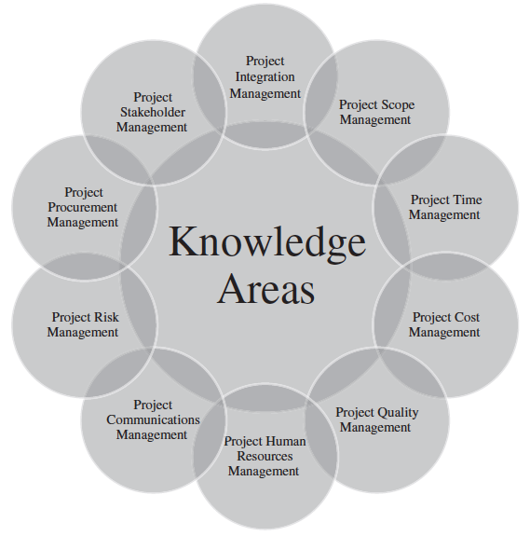
Figure 2.2 – The PMBOK® Guide 6th Edition – The 10 Knowledge Areas
2-<number>

Slide 10
PMBOK® Guide 6th Edition – The 10 Project Management Knowledge Areas
Project integration management
Project scope management
Project time management
Project cost management
Project quality management
Project human resource management
Project communications management
Project risk management
Project procurement management
Project stakeholder management
2-<number>

Slide 11
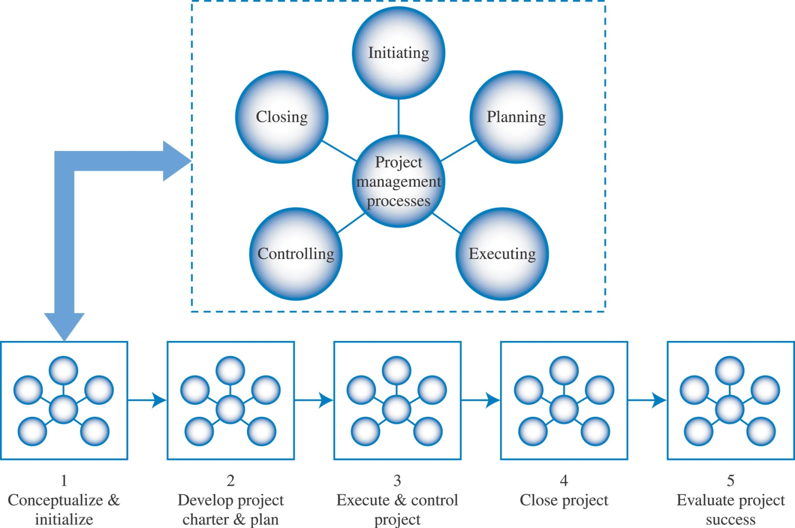
Figure 2.3 – PMBOK® Project Management Process Groups
2-<number>

Slide 12
The Five (5) PMBOK® Project Management Process Groups
Initiating
Planning
Executing
Monitoring and Controlling
Closing
2-<number>

Slide 13
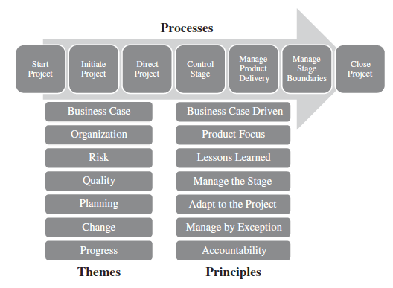
Figure 2-4 – PRINCE2® – The Seven (7) Processes
2-<number>

Slide 14
The PRINCE2® – Seven (7) Processes
PRINCE2® = Projects IN Controlled Environments
Start Project
Initiate Project
Direct Project
Control Stage
Manage Product Delivery
Manage Stage Boundaries
Close Project
2-<number>

Slide 15
The PRINCE2® – Themes (guidelines to aid project goal achievement)
PRINCE2® = Projects IN Controlled Environments
Business Case
Organization
Risk
Quality
Planning
Change
Progress
2-<number>

Slide 16
The PRINCE2® – Principles (Universal guidance for all projects)
PRINCE2® = Projects IN Controlled Environments
Business Case Driven
Product Focus
Lessons Learned
Manage the Stage
Adapt to the Project
Manage by Exception
Accountability
2-<number>

Slide 17
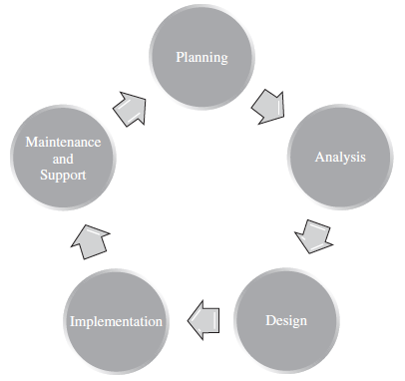
Figure 2.5 The Systems Development Life Cycle
2-<number>

Slide 18
Systems Development Life Cycle (SDLC)
Planning
Analysis
Design
Implementation
Maintenance and Support
2-<number>

Slide 19
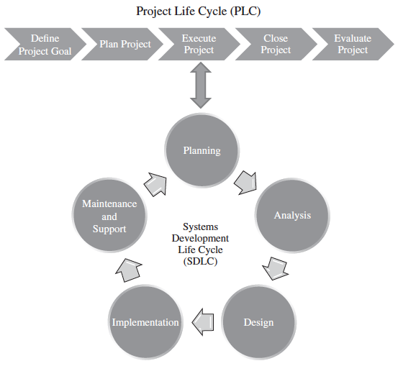
Figure 2.6 – The Project Life Cycle (PLC) and the Systems Development Life Cycle (SDLC)
2-<number>

Slide 20
Implementing the SDLC
Defines all of the subphases and deliverables associated with the Execute and Control Project Management Life Cycle phase.
Number of Ways to implement the SDLC
  Waterfall
  Agile
2-<number>

Slide 21
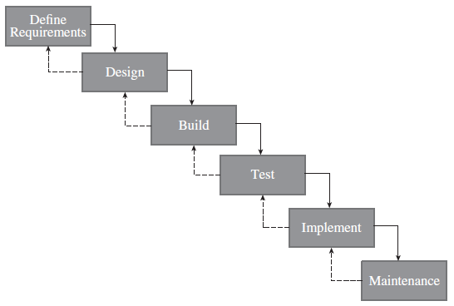
Figure 2.7 – The Waterfall Model
2-<number>

Slide 22
Agile Systems Development – What is Agile?
Condenses the SDLC into an iteration or sprint
Users and developers work closely together to define and prioritize important (“must have”) features
Emphasize working software to measure progress and rely heavily on face-to-face communication
Umbrella term that includes a number of approaches or methods
2-<number>

Slide 23
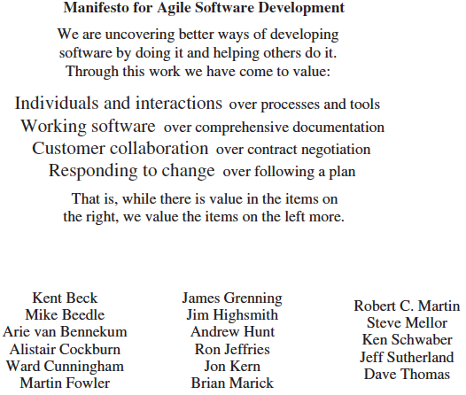
Figure 2.8 – The Agile Manifesto
2-<number>

Slide 24
Agile Systems Development – Four (4) Themes or Categories
Customer
Product
Project Team
Performance
2-<number>

Slide 25
Agile Methods: Extreme Programming (XP) and Scrum
Methods for project management that are becoming increasingly popular
Characterize many of today’s projects that exemplify speed, uncertainty, changing requirements, and high risks
XP
  User requirements first documented as user stories
  Document user stories in an object oriented model called a class diagram
  Transfers the system in a series of versions called releases
Scrum
  Three important roles:
    Scrum master – similar to project manager
    Product owner – represents the business side, ensures the most important features are included
    Development team – responsible for delivering a quality product or system
  Product backlog – team prioritizes features that need to be developed/delivered
  Sprint – iterations lasting a few weeks (usually) and delivers a complete product
  Daily scrum – short stand-up meeting
2-<number>

Slide 26
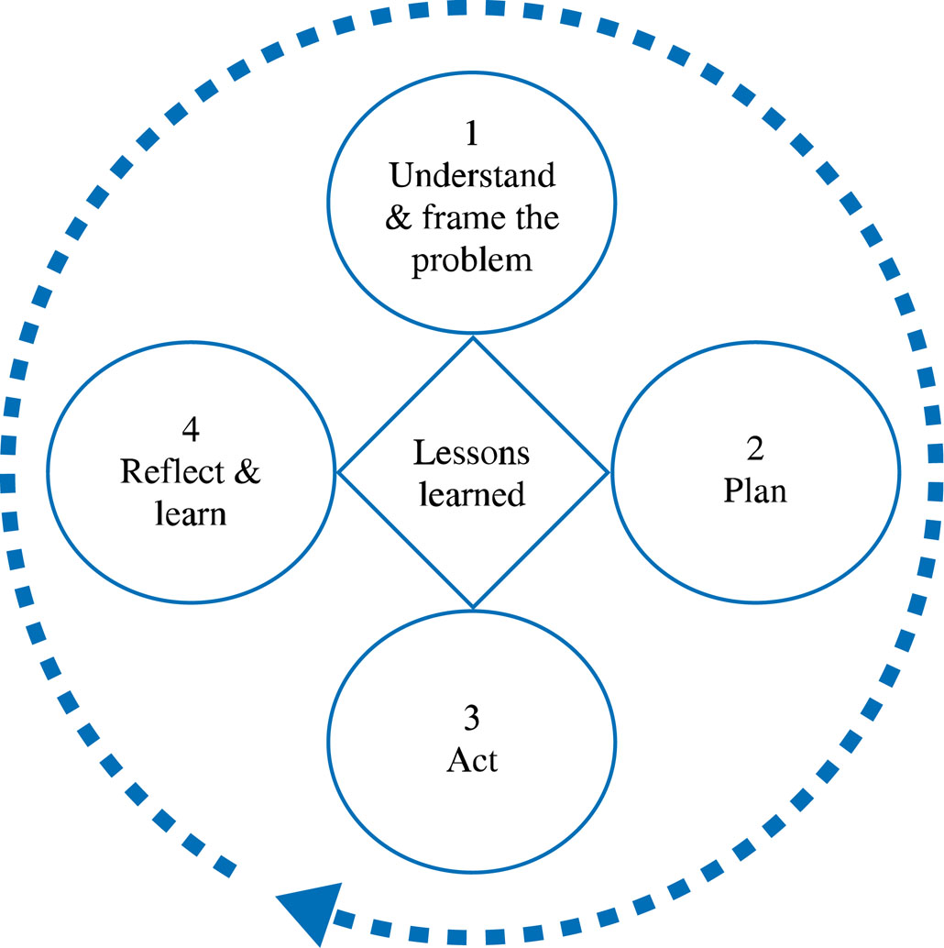
Figure 2.10 – A Learning Cycle
2-<number>

Slide 27
Figure 2.11 – An Example of a Team Learning Record
What we know (Facts) | What we think we know (Assumptions) | What we don’t know (Questions to be Answered)
Company has too much inventory on hand | It may be an efficiency problem | Why are inventory levels so high?
Cost of maintaining current inventory is becoming prohibitive | Management believes a new information system will improve efficiency and therefore lower inventory levels | What are the current levels of inventory?
Inventory turnover needs to be increased |  | What is the desired level of inventory?
2-<number>

Slide 28
Figure 2.12 – An Example of an Action Plan
Who? | Does What? | By When?
Shedelle and Steve | Interview sales team to understand past, current, and future trends for the company’s product. | Tuesday
Myra | Provide a detailed count of the current physical inventory on hand. | Thursday
Corean | Research potential inventory management system commercial packages | Thursday
Steve | Research average inventory levels for the industry | Wednesday
2-<number>

Slide 29
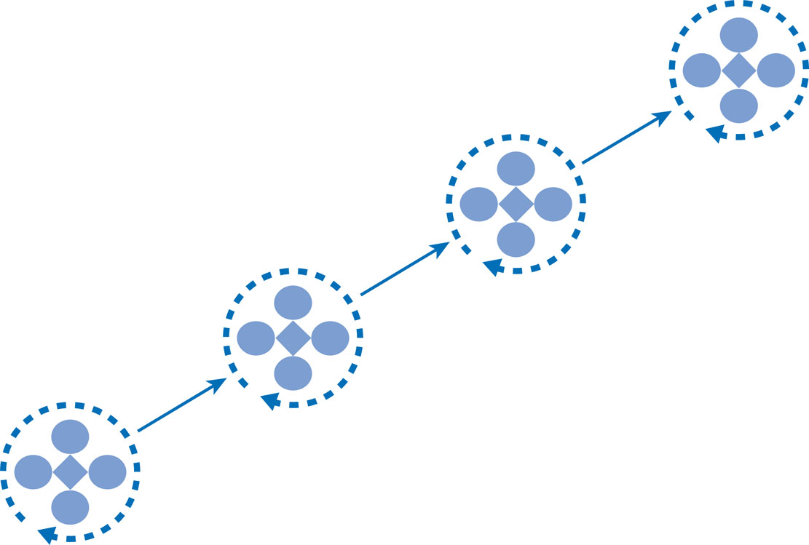
Figure 2.13 – Team Learning Cycles over the Project Life Cycle
Each cycle provides the opportunity to
challenge framing assumptions, create new understanding & find radical solutions
2-<number>

Slide 30
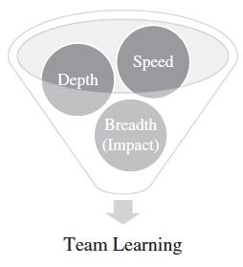
Team Learning
2-<number>

